Slide 1
CONTINUOUS NEURAL REPRESENTATIONS FOR MEDICAL IMAGING
Beyond Reconstruction: Measuring What Metrics Missing
Medical Images
CNRs
Reconstruction
(Dice, HD95, ASD)
Representation
(Geometry, Latent, RFI)
Can reconstruction accuracy faithfully characterize a continuous neural representation?
Pronab Kumar Paul, Department of Information and Communication Engineering, University of Rajshahi

Slide 2
Can reconstruction accuracy faithfully characterize a continuous neural representation?
THE QUESTION MOTIVATING THIS WORK

Slide 3
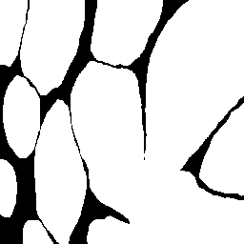




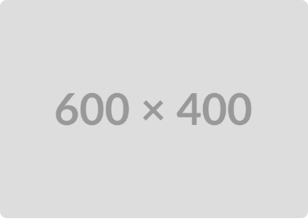
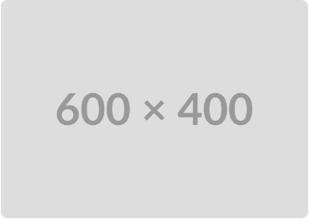

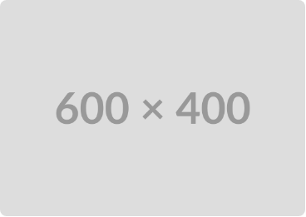
Are High Dice Scores Enough?
Can identical reconstruction imply identical learned representations?
Ground Truth
Model A (Dice=0.994)
Model B (Dice=0.985)
Original Target Structure

Slide 4
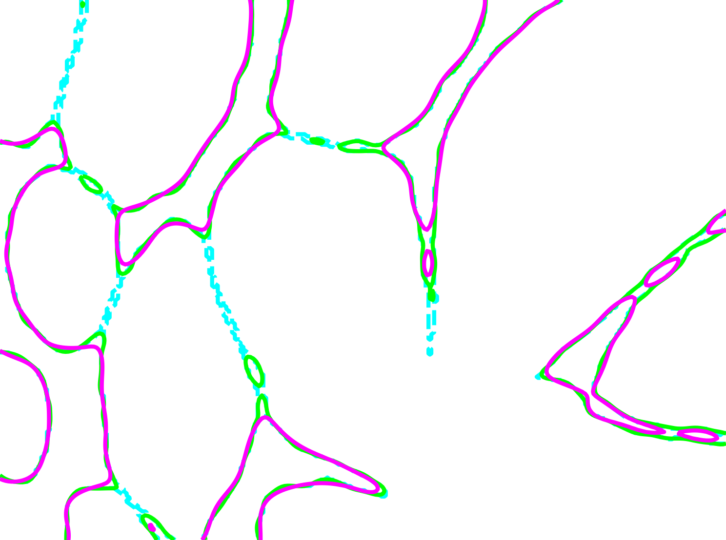
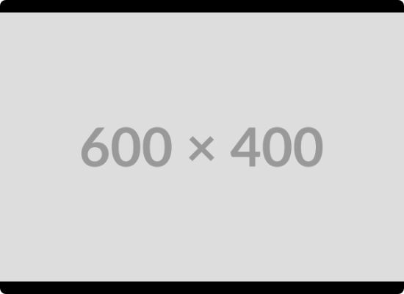
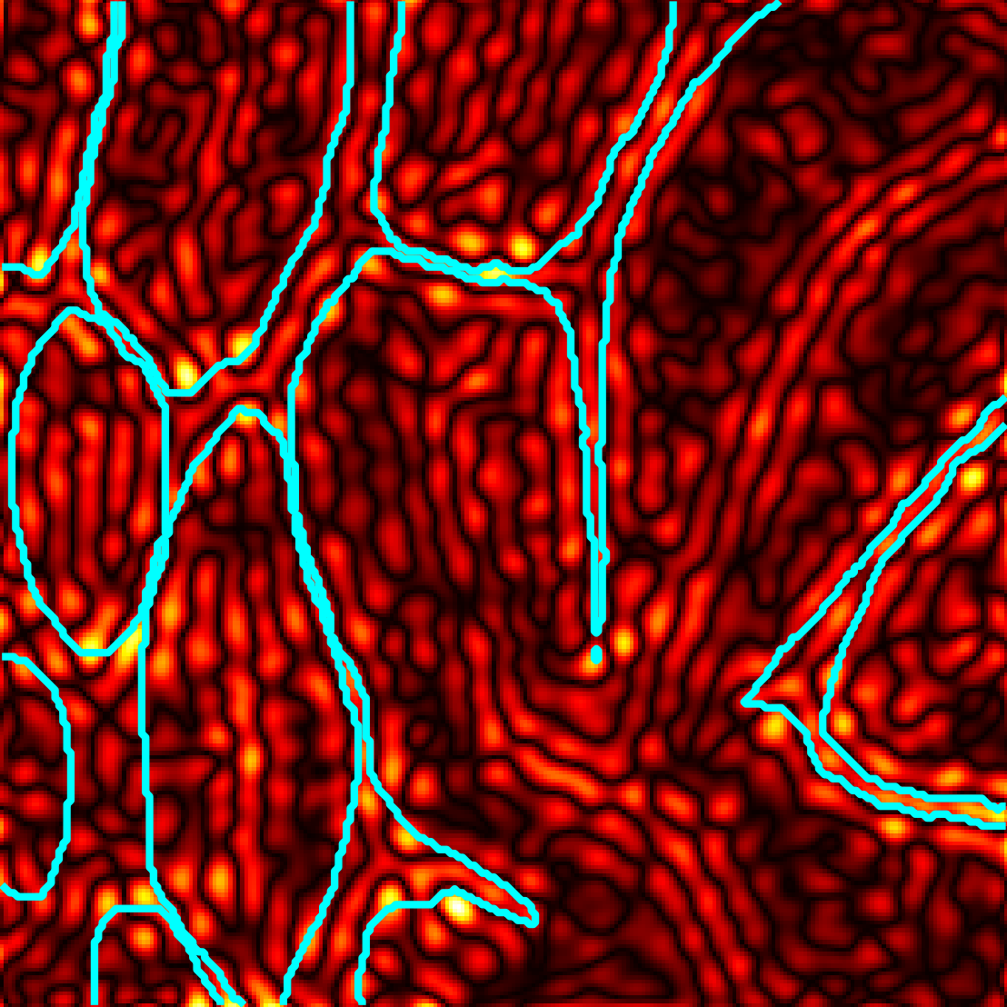
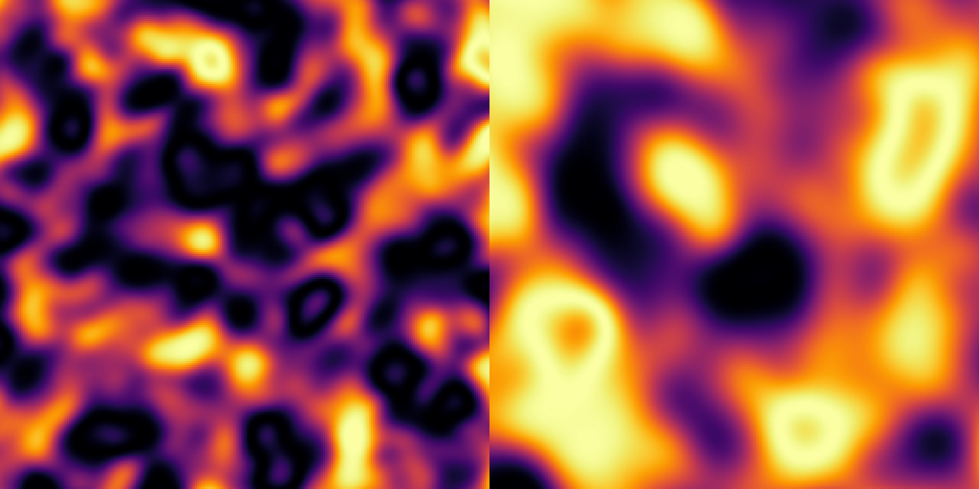


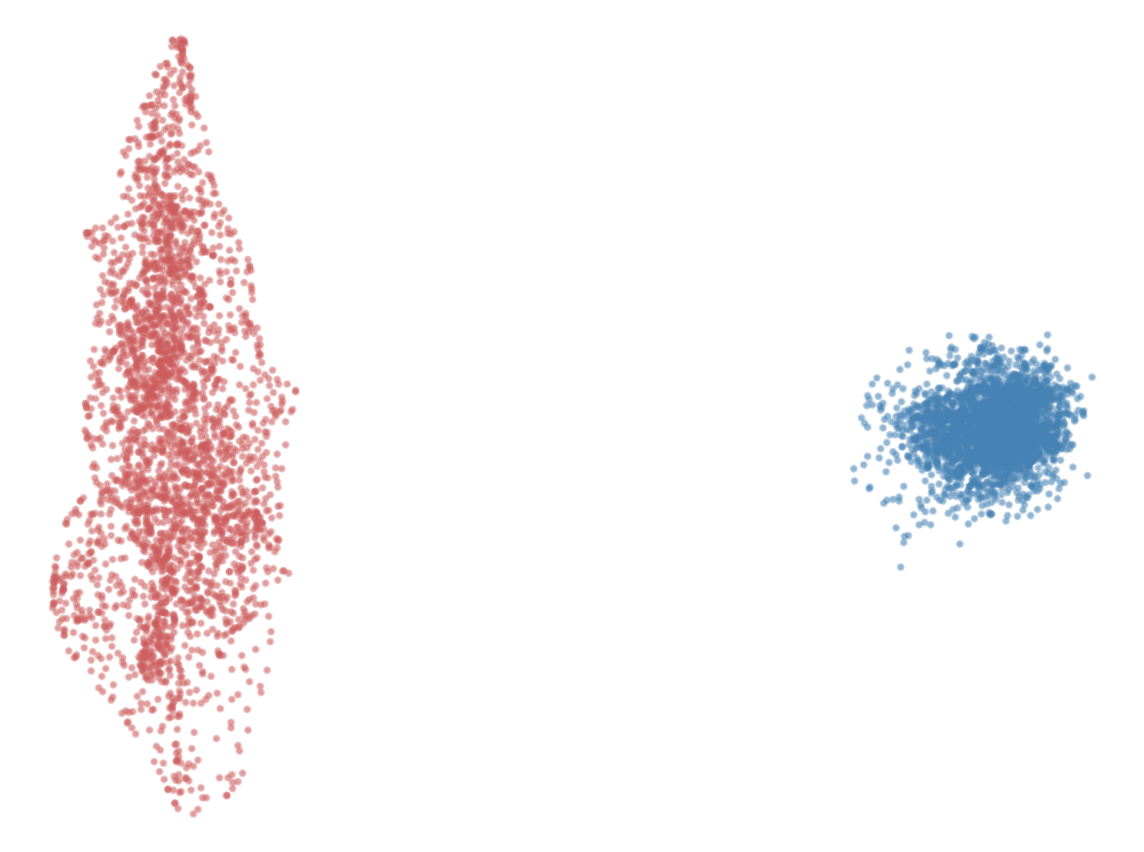
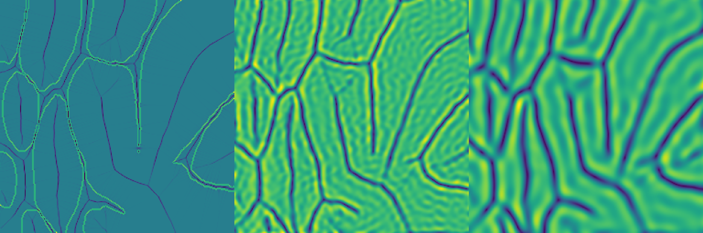
Why Reconstruction Can Be Misleading
→
Equivalent reconstruction performance
→
Different learned representations
→
Different representational fidelity
→
Conventional reconstruction metrics cannot detect these differences
→
Representation-aware evaluation is needed
Equivalent Reconstructions Can Hide Different Representations.

Slide 5
Equivalent Reconstruction ≠ Equivalent Representation
"
"
Equivalent reconstructions can hide substantial differences in representational fidelity.
Representational fidelity: The extent to which anatomically meaningful information is preserved within the learned representation.

Slide 6
Research Questions
Characterization
How do learned representations differ despite equivalent reconstruction?
Quantification
Can a composite Representational Fidelity Index (RFI) quantify these differences?
Generalization
Do these findings generalize across datasets and model architectures?

Slide 7
Proposed Evaluation Framework
Continuous Neural Representation (CNR) Learning
Learned Continuous Model
Reconstruction Evaluation
Dice • HD95 • ASD
Representational Fidelity Evaluation
Geometry • Latent • RFI
Statistical Comparison
Hypothesis Evaluation

Slide 8
How is RFI Computed?
Representational Fidelity Index (RFI) integrates geometric fidelity and latent representation quality into one score.
Geometry Index (GeoIndex)
Latent Index (LatentIndex)
• Gradient Error
• Curvature Error
• Topology Error (Euler Characteristic)
• Effective Rank
• Spectral Entropy
• Participation Ratio
Standardize All Metrics (Z-score)
RFI = (GeoIndex + LatentIndex) / 2
CKA reported separately to validate latent-space divergence.
08

Slide 9


Experimental Validation
DRIVE Dataset
GLAS Dataset
→
20 retinal images
→
20 histological images
→
3 random seeds per model
→
2 random seeds per model
→
Matched reconstruction pair identified
→
Statistical Test: TOST equivalence
→
Wilcoxon + Holm
→
Equivalence bound ±0.02
Both datasets produced statistically equivalent reconstruction while revealing substantial representational differences.

Slide 10
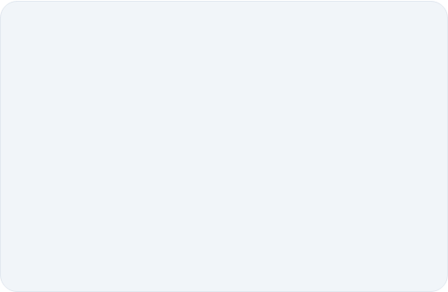
DRIVE Dataset: Equivalent Reconstruction
~0.0
Metric | SIREN-128 | SIREN-112 | Result
Dice ↑ | 0.722 | 0.719 | ✓ ns
HD95 ↓ | 5.81 | 5.83 | ✓ ns
ASD ↓ | 0.610 | 0.616 | ✓ ns
P-VALUE DIFF (NS)
Wilcoxon + Holm: all adjusted p > 0.05
Standard reconstruction metrics indicate that the two models are equivalent.
10

Slide 11
DRIVE: Representational Fidelity
Representation Metrics
Geometry Metrics
Metric | SIREN-128 | SIREN-112 | Result
RFI ↑ | −0.234 | −0.145 | p < 0.0001
LatentIndex ↑ | −0.286 | −0.150 | p < 0.0001
Effective Rank ↑ | 84.84 | 74.02 | Significant
Metric | SIREN-128 | SIREN-112 | Result
Gradient Error ↓ | 30.44° | 30.55° | p = 0.040
Curvature Error ↓ | 0.955 | 0.960 | p = 0.033
Vessel Width Error ↓ | 2.60 | 2.67 | trend (p = 0.097)
Effective Rank: 84.84 → 74.02 (≈13% lower)
LatentIndex: −0.286 → −0.150 (large effect)
RFI: −0.234 → −0.145 (Cohen's d = −2.65)
Despite equivalent reconstruction, the learned representations differ significantly across latent and geometric analyses.

Slide 12
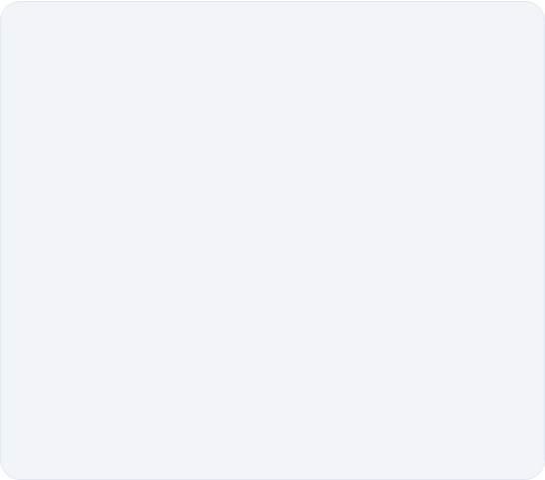
GLAS Dataset: Equivalent Reconstruction
Reconstruction Metrics
< 0.0001
Model | Dice ↑ | HD95 ↓ | ASD ↓
SIREN-128 | 0.995 | 1.85 | 0.151
SIREN-128 + Eikonal | 0.995 | 2.15 | 0.184
SIREN-128 + Jacobian | 0.995 | 2.08 | 0.177
SIREN-128 LowOmega (ω₀=15) | 0.986 | 5.43 | 0.591
TOST P-VALUE
All pairs equivalent
Standard reconstruction metrics suggest that all four models are equivalent.

Slide 13
GLAS: Representational Fidelity
Representation Metrics
Structural Differences
Model | RFI ↓ | Effective Rank ↑ | Participation Ratio ↑
SIREN-128 | −0.303 | 74.44 | 51.73
SIREN-128 + Eikonal | −0.296 | 74.08 | 51.41
SIREN-128 + Jacobian | −0.322 | 74.29 | 51.58
SIREN-128 LowOmega (ω₀=15) | +0.920 | 43.54 | 28.46
Metric | SIREN-128 | LowOmega
Gradient Error | 10.58° | 12.45°
Curvature Error | 1.010 | 1.042
GeoIndex | −0.131 | 0.462
LatentIndex | −0.475 | 1.379
✓ 41% reduction in Effective Rank ✓ ≈45% reduction in Participation Ratio
✓ RFI shifted from −0.303 to +0.920 ✓ Non-overlapping 95% confidence intervals
Equivalent reconstruction concealed substantial degradation in geometric fidelity and latent representation quality.

Slide 14
Consistency Across Datasets
Dataset | Reconstruction | Representation
DRIVE (Retinal Vessels) | Equivalent | Significantly Different
GLAS (Gland Structures) | Equivalent | Significantly Different
2 / 2
datasets confirm
representation divergence
Equivalent reconstruction does not imply equivalent learned representations.
The phenomenon replicates across anatomically distinct datasets.

Slide 15
Why Does This Happen?
Model A
Model B
Reduced feature diversity
Greater feature diversity
↓
↓
Fewer active feature directions
More active feature directions
↓
↓
Lower effective rank (observed)
Higher effective rank (observed)
↓
↓
Reduced latent representation richness (observed)
Richer latent representation (observed)
↓
↓
Equivalent reconstruction despite reduced representational fidelity
Equivalent reconstruction with higher representational fidelity
Equivalent reconstruction may arise from fundamentally different internal representations because reconstruction evaluates the final output, not how anatomical information is organized within the learned feature space.

Slide 16
CONCLUSION
Current Paradigm
Model quality inferred from reconstruction performance
Proposed Paradigm
Model quality evaluated through reconstruction and representational fidelity
➔
Findings
✓ Equivalent reconstruction does not imply equivalent learned representations.
✓ RFI quantifies representational fidelity beyond reconstruction metrics.
✓ The phenomenon was consistently observed across DRIVE and GLAS datasets.
✓ Representation-aware evaluation provides a more complete assessment of continuous neural representations.
Accurate reconstruction does not necessarily imply faithful learned representations.
Toward representation-aware evaluation for more reliable medical AI.

Slide 17




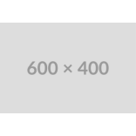
Questions?
"Accurate reconstruction does not necessarily imply faithful learned representations."
Pronab Kumar Paul
University of Rajshahi
pronabpaul77@gmail.com
github.com/pronabpaul/revealing-representational-fidelity
SCAN TO ACCESS

